Slide 1
Jagger´s Daily Routine
João Caló nº 17 6º E

Slide 2
Hello!! My name is Jagger
and I’m going to tell you about my daily routine!!!

Slide 3
In
the morning…

Slide 4
I wake up at 6 o´clock in the morning. Then I have breakfast at 6:50 a.m. I usually eat earthworms with milk.
At 7:00 a.m. I brush my teeth. I have a shower and I comb my hair.
At 7:30 a.m. I go to the Alien School.
My favourite subject is English, because I want go to Planet Earth and be with humans.
At 1:15 p.m. I return home and I have lunch. I always eat stones with moss and I drink a glass of snail slime.

Slide 5
In
the afternoon …

Slide 6
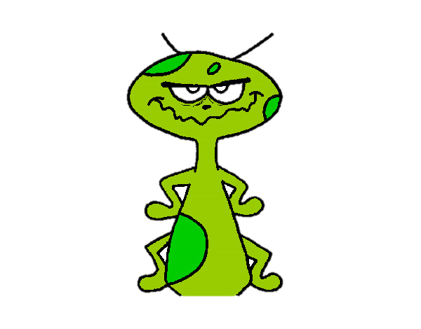
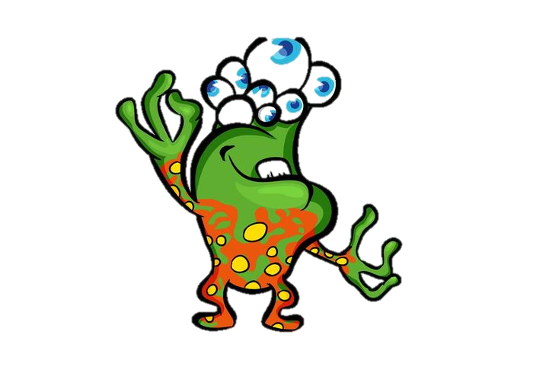
This is my favourite part of the day!!!
At 1 o´clock p.m. I go to the park with my friends, 500 Eyes and Green One. We play E.T. football.
At 3 o´clock p.m. we go to Ice Cream Parlour . I love spider ice cream.
At 4:05 p.m. I go home and I do my homework.

Slide 7
In
the evening …

Slide 8
At 5:00 p.m. I have a snack. I drink a glass of juice and eat a cricket sandwich.
After my snack I watch TV. I love documentaries about wildlife.
At 6:00 p.m. I surf the net and I play some video games .

Slide 9
At night…

Slide 10
At 8:15 p.m. I have dinner with my parents. My favourite food is smashed potatoes with snails.
I love
my
parents.
At 9:30 p.m. I brush my teeth. Then I go to bed and I sleep.

Slide 11
Goodbye!!!
I hope you liked my daily routine.

Slide 12
Text written by João Caló
Jagger’s Picture: http://www.crazywebsite.com/Free-Galleries-01/Alien_Spaceships_Extraterrestrial_Aliens_Art/pg-ETs_Spacecraft_Strange_Creatures/Aliens_Authentic_Real_Genuine_Clipart-01.html

